Slide 1
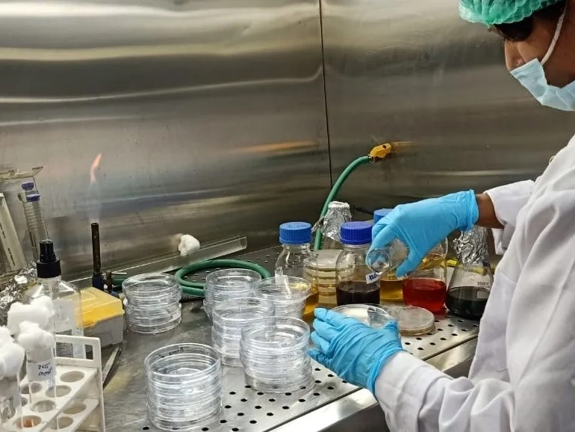
Delhi Analytical Research Laboratory
(DARL)
Timely and effective lab services

Slide 2
What we do
DARL is an organization lead by technocrat(s) in the field of analysis and research in the following fields.
Food and food products.
Beverages (Fruit based, alcoholic and non alcoholic).
Agricultural product(s)
Environmental analysis.
Bench mark studies.
Shelf life studies.
New product(s) development assistance to stake holders.
Clinical trial studies for the developed product(s).
Providing regulatory related consultancy to the stake holders.

Slide 3
Our Accreditations/Empanelments
FSSAI(Food Safety Standard Authority of India, Ministry of Health Government of India) empanelled
MOEF(Ministry of environment and Forest)recognized
Approved from Ministry of Ayurveda, Yoga & Naturopathy Unani, Siddha and Homeopathy(AYUSH), Government of India
ISO:9001:2015 (Quality Management Standard)
ISO:45000

Slide 4
Product Development
Red rice and white rice wine was developed under the project of a student from Gautam Budh University Noida with natural sapota and orange flavour.
Low glycemic indexed products were developed for leading industry and trial for the same were concluded in association with National Agri Food Biotechnology Institute and Post Graduate Institute for Medical Education and Research Chandigarh, paper publishing process for same is on.
Many more products are in the process of development.

Slide 5

Vision
DARL is committed to provide science based solution(s) to its stakeholders as per National and International standards, as per regulatory standard and compliances in transparent/ethical manner.
Further to is committed to seek an international alliance in the field thereby making sure to provide safe food and beverages to the society globally as well taking care of the environment safety for future generation(s).
This Photo by Unknown Author is licensed under CC BY-SA

Slide 6
Stakeholders Associated With Us
Government of NCT Delhi for analysis of food being provided under Mid Day Programme.
Imported food samples being routed for analysis by FSSAI.
Food Corporation of India for analysis of Wheat and Rice.
Leading Food Business Operator like PARLE, PEPSI, Godrej, DelMonte, Cremica and many more.
In environment organizations like Larsen and Toubro, Reliance, BSES, TCS etc.
Benchmark studies like Okaya, Godrej and Boyce etc.
Soil testing Embassy of United States in Delhi.
Water testing for Embassy of France, Italy etc.
We are official partner with the state of Uttrakhand for testing reference samples of water under National Rural Drinking Water Project.

Slide 7
Our Strength
People are the pillar of organization.
Our strength is our people associated with us who are technically qualified and are getting updated regularly with new technique(s) with inhouse as well as outside training exposure.

Slide 8
Contact
Delhi Analytical Research Laboratory
Plot 2A
Jhilmil Industrial Area
Near Dilshad Garden Metro Station
Delhi, 95
Website: www.darltesting.in
Email: darltesting@gmail.com
WhatsApp: +919717324010

